Slide 2
Build your Microservices the Easy Way with OperatorHub
Masa Abushamleh
Cloud Developer Advocate
Lungelo Sikobi
Developer Advocate

Slide 3

Contents
Introducing Red hat OpenShift
Operators
Operator Framework
OperatorHub
Code lab
Useful Resources
Build your Microservices the Easy Way with OperatorHub/ December 19,, 2020 / © 2020 IBM Corporation
Notes:
Add number of slides later

Slide 4
Create your IBM Cloud account at: https://ibm.biz/BdqN6D
Workshop resources: https://github.com/nerdingitout/oc-serverless
OpenShift Cluster
URL: https://oc-ophub.mybluemix.net/
Key: oslab
Build your Microservices the Easy Way with OperatorHub/ December 19, 2020 / © 2020 IBM Corporation
Notes:
Add number of slides later

Slide 5

Build your Microservices the Easy Way with OperatorHub/ December 19, 2020 / © 2020 IBM Corporation

Slide 6

What is OpenShift
Red Hat OpenShift is a platform for deploying cloud-native, microservices based applications. It can be hosted locally, or on a public cloud.
Supports Java™, Python, Ruby, Node.js, Perl, PHP, .NET, and more
Built on Kubernetes and deployed on Red Hat Enterprise Linux® CoreOS (RHCOS) and Red Hat Enterprise Linux (RHEL)
Build your Microservices the Easy Way with OperatorHub/ December 19, 2020 / © 2020 IBM Corporation

Slide 7
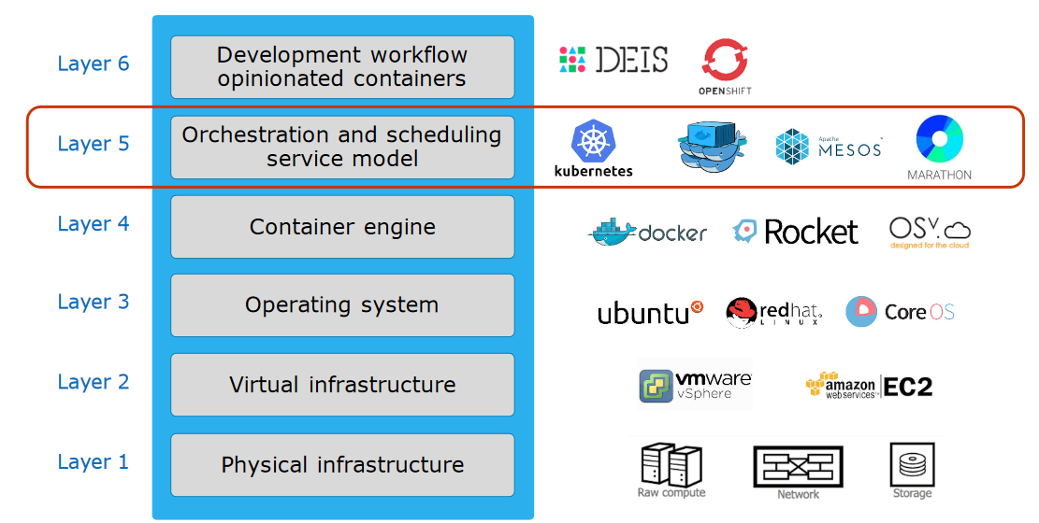
Build your Microservices the Easy Way with OperatorHub/ December 19, 2020 / © 2020 IBM Corporation

Slide 8
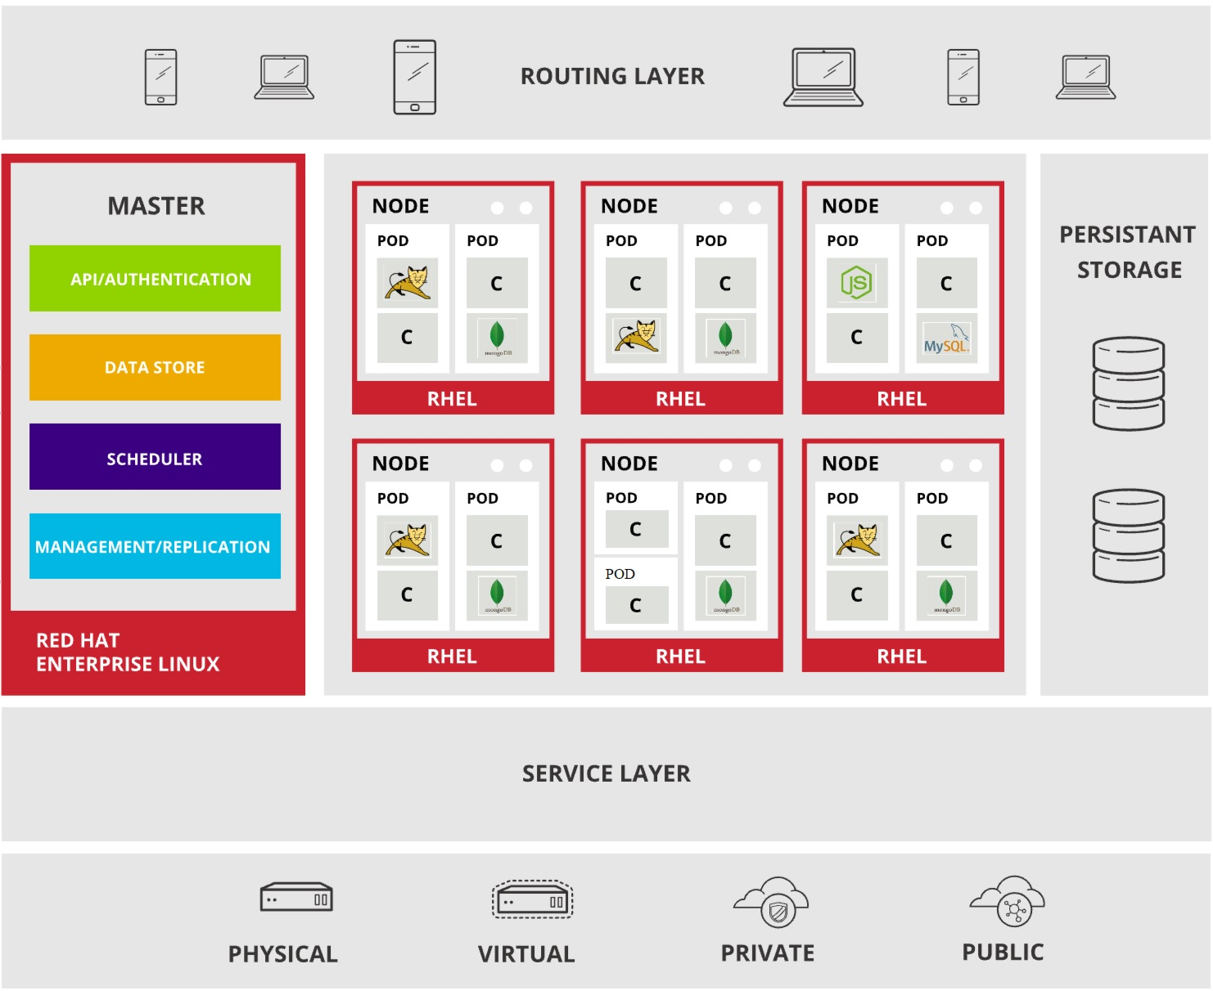
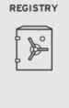
OpenShift Architecture & Components
Build your Microservices the Easy Way with OperatorHub/ December 19, 2020 / © 2020 IBM Corporation
Notes:
OpenShift Architecture & Components
The diagram shows the architecture and components of OpenShift
OpenShift consists of layers, the bottom layer indicates that you can deploy your application on physical machines, virtual machines or the cloud (public/private)
Service layer
- Defines logical set of pods and access policy, provides permanent IP address and host name
- connects application components together
- Services allow simple internal load balancing across application components
We have two main types of nodes:
Worker nodes and master nodes
Master nodes: controls and manages a set of worker nodes and resembles the cluster.
- Systems interact with the API, all administration requests goes through this API, all requests are SSL-encrypted and authenticated
Etcd: data store for state and other info related to environment and application
Health and scaling: master nodes monitor health of pods and scale them based on CPU utilization. In case of pod failure, master node restarts pods automatically, if they fail too often they are marked as bad and temporarily not restarted. Service layer sends traffic only to healthy pods
Scheduler: responsible for determining pod placements taking into account for current memory, CPU and other environment utilization
Registry is where the container images are stored and managed. When new image pushed to registry, registry notifies openshift and passes image information.
Persistent Storage: since data is not saved in containers when created or restarted, OpenShift provides a persistent storage where all data is saved and connected to correct pods. This allows use of stateful applications
Worker nodes: VM or physical machine / contains the services necessary to run pods and is managed by the master components
Nodes include pods:
Earlier we mentioned that a pod is the smallest unit that can be defined, deployed and managed
Contains one or more containers deployed together on one host sharing the same volume and IP address
One or more pods can be in one node
Orchestrated unit in OpenShift
OpenShift schedules and runs all containers in pod on same node
Can have side car containers: cluster features such as service mesh or security analysis
Individual applications scaled horizontally
Applications are wired together by services
Routing layer Provides external clients access to applications running inside OpenShift.
It provides:
- Automated load balancing to pods for external clients
- Load balancing and auto-routing around unhealthy pods

Slide 9






Simplified cluster
management
Design your
own cluster
Security
& isolation
Extend apps with IBM Cloud services
Native open-source
experience
Integrated
operational tools
Build your Microservices the Easy Way with OperatorHub/ December 19, 2020 / © 2020 IBM Corporation

Slide 10
Operators
Build your Microservices the Easy Way with OperatorHub/ December 19, 2020 / © 2020 IBM Corporation

Slide 11
What are Operators?
Operators are pieces of software that ease the operational complexity of running another piece of software.
A method of packaging, deploying, and managing a Kubernetes application.
Build your Microservices the Easy Way with OperatorHub/ December 19, 2020 / © 2020 IBM Corporation

Slide 12
Why use Operators?
Repeatability of installation and upgrade.
Constant health checks of every system component.
Over-the-air (OTA) updates for OpenShift components and ISV content.
A place to encapsulate knowledge from field engineers and spread it to all users, not just one or two.
Build your Microservices the Easy Way with OperatorHub/ December 19, 2020 / © 2020 IBM Corporation

Slide 13
How Operators Work?
Operators can reduce complexity
Operators extend Kubernetes functionality
Operators take human knowledge and systemize it as code
Operators make application management more scalable and repeatable
Operators are useful in multi-cloud and hybrid cloud environments
Build your Microservices the Easy Way with OperatorHub/ December 19, 2020 / © 2020 IBM Corporation

Slide 14
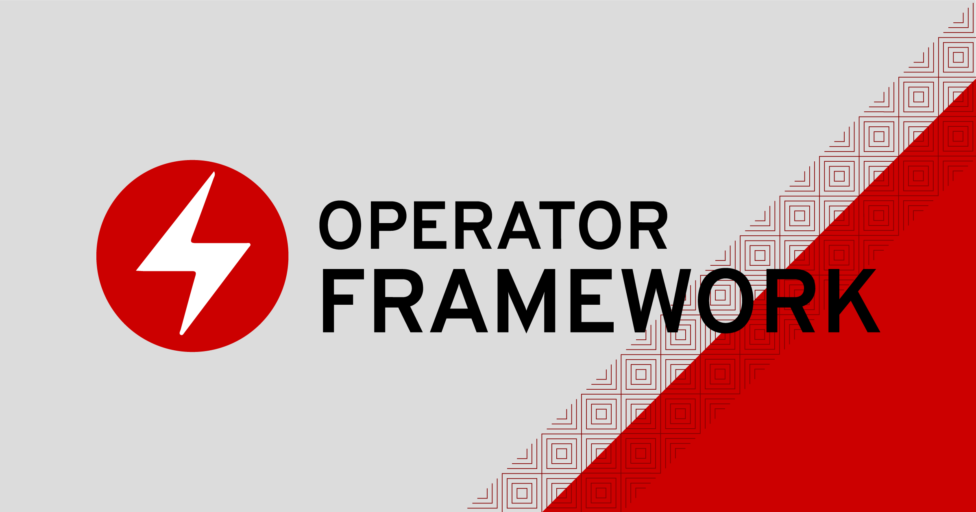
Operator Framework
Operator SDK
Operator Lifecycle Manager (OLM)
Operator Registry
OperatorHub
Operator Metering
Build your Microservices the Easy Way with OperatorHub/ December 19, 2020 / © 2020 IBM Corporation
Notes:
Operator SDK assists Operator authors in bootstrapping, building, testing, and packaging their own Operator based on their expertise without requiring knowledge of Kubernetes API complexities.
Operator Lifecycle Manager (OLM) controls the installation, upgrade, and role-based access control (RBAC) of Operators in a cluster. Deployed by default in OpenShift Container Platform 4.4.
Operator Registry stores ClusterServiceVersions (CSVs) and Custom Resource Definitions (CRDs) for creation in a cluster and stores Operator metadata about packages and channels. It runs in a Kubernetes or OpenShift cluster to provide this Operator catalog data to the OLM.
OperatorHub is a web console for cluster administrators to discover and select Operators to install on their cluster. It is deployed by default in OpenShift Container Platform.
Operator Metering collects operational metrics about Operators on the cluster for Day 2 management and aggregating usage metrics.

Slide 15
OperatorHub
The OperatorHub is available via the OpenShift Container Platform web console and is the interface that cluster administrators use to discover and install Operators.
Cluster administrators can choose from OperatorSources grouped into the following categories:
Red Hat Operators
Certified Operators
Community Operators
Custom Operators
Build your Microservices the Easy Way with OperatorHub/ December 19, 2020 / © 2020 IBM Corporation
Notes:
With one click, an Operator can be pulled from their off-cluster source, installed and subscribed on the cluster, and made ready for engineering teams to self-service manage the product across deployment environments using the Operator Lifecycle Manager (OLM).

Slide 16
OperatorHub
The OperatorHub is available via the OpenShift Container Platform web console and is the interface that cluster administrators use to discover and install Operators.
Cluster administrators can choose from OperatorSources grouped into the following categories:
Red Hat Operators
Certified Operators
Community Operators
Custom Operators
Build your Microservices the Easy Way with OperatorHub/ December 19, 2020 / © 2020 IBM Corporation
Notes:
With one click, an Operator can be pulled from their off-cluster source, installed and subscribed on the cluster, and made ready for engineering teams to self-service manage the product across deployment environments using the Operator Lifecycle Manager (OLM).

Slide 17
Operator SDK
The Operator SDK is a framework designed to make writing Operators easier by providing:
High-level APIs and abstractions to write the operational logic more intuitively
Tools for scaffolding and code generation to quickly bootstrap a new project
Extensions to cover common Operator use cases
Build your Microservices the Easy Way with OperatorHub/ December 19, 2020 / © 2020 IBM Corporation
Notes:
The Operator SDK provides the following workflow to develop a new Operator:
1- Create a new Operator project using the Operator SDK command line interface (CLI).
2- Define new resource APIs by adding Custom Resource Definitions (CRDs).
3- Specify resources to watch using the Operator SDK API.
4- Define the Operator reconciling logic in a designated handler and use the Operator SDK API to interact with resources.
5- Use the Operator SDK CLI to build and generate the Operator deployment manifests.

Slide 18
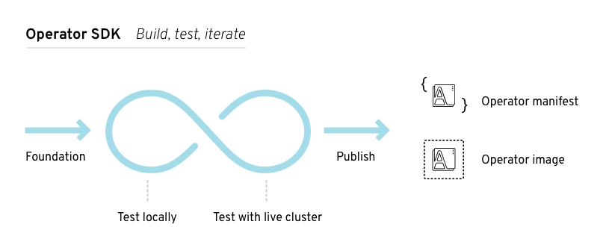
Operator SDK Workflow
Build your Microservices the Easy Way with OperatorHub/ December 19, 2020 / © 2020 IBM Corporation
Notes:
The Operator SDK provides the following workflow to develop a new Operator:
1- Create a new Operator project using the Operator SDK command line interface (CLI).
2- Define new resource APIs by adding Custom Resource Definitions (CRDs).
3- Specify resources to watch using the Operator SDK API.
4- Define the Operator reconciling logic in a designated handler and use the Operator SDK API to interact with resources.
5- Use the Operator SDK CLI to build and generate the Operator deployment manifests.

Slide 19
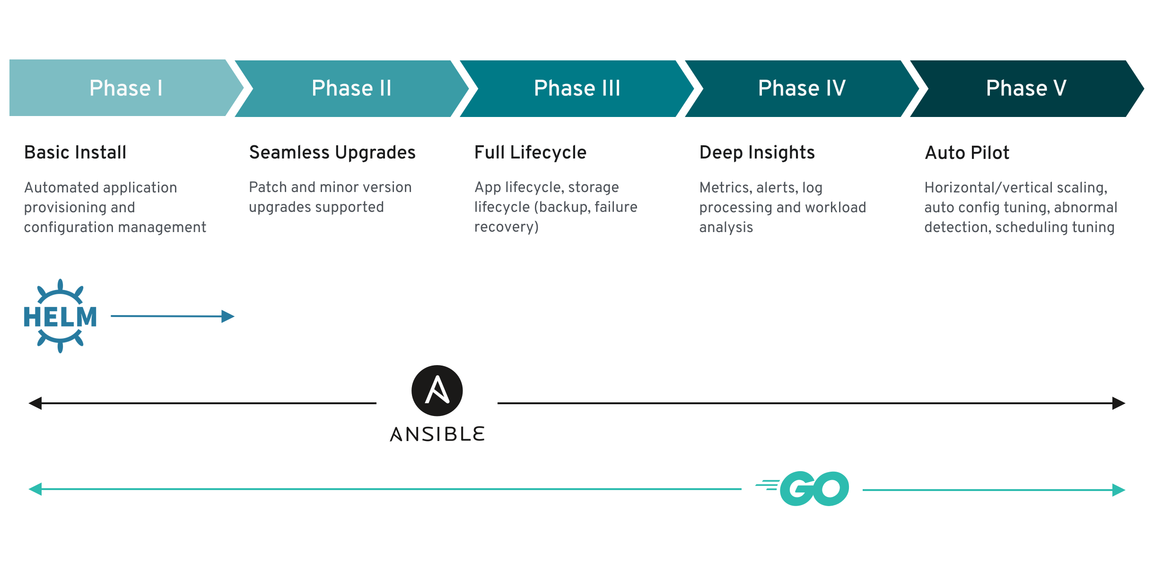
Operator maturity model
Build your Microservices the Easy Way with OperatorHub/ December 19, 2020 / © 2020 IBM Corporation

Slide 20
Code lab
Build your Microservices the Easy Way with OperatorHub/ December 19, 2020 / © 2020 IBM Corporation

Slide 21
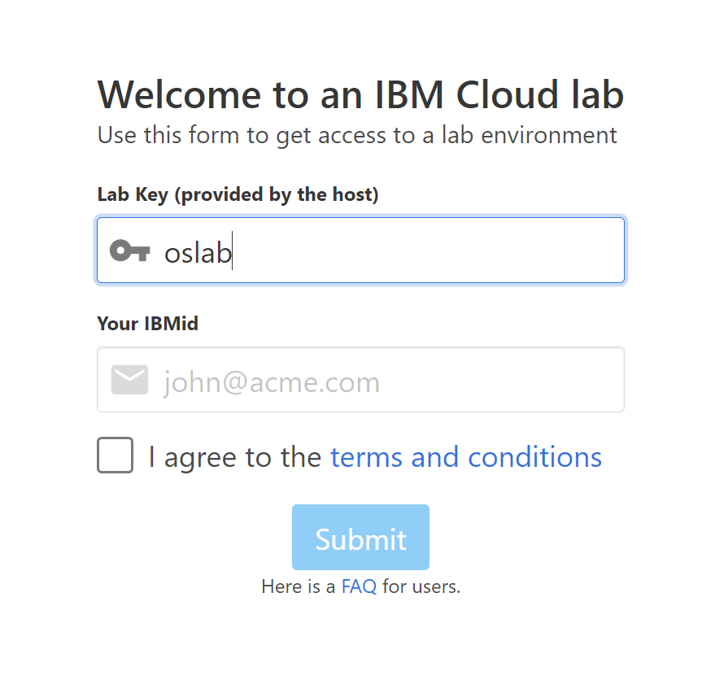
Workshop resources: https://github.com/nerdingitout/oc-serverless
Build your Microservices the Easy Way with OperatorHub/ December 19, 2020 / © 2020 IBM Corporation

Slide 22
Summary
OpenShift 4 is built on top of operators.
Operators can be built with Operator Framework SDK.
Operators help ease the operational complexity of running another piece of software.
OpenShift Administrators can install operators from OperatorHub.
Operators can be installed on the whole cluster on specific projects.
Build your Microservices the Easy Way with OperatorHub/ December 19, 2020 / © 2020 IBM Corporation

Slide 23
Useful Links
IBM Developer: http://developer.ibm.com/
Red Hat Developer: https://developers.redhat.com/
Learning:
https://learn.openshift.com/
https://cognitiveclass.ai/
Build your Microservices the Easy Way with OperatorHub/ December 19, 2020 / © 2020 IBM Corporation

Slide 24

Survey
https://www.surveymonkey.com/r/H7SZXWH
Build your Microservices the Easy Way with OperatorHub/ December 19, 2020 / © 2020 IBM Corporation

Slide 25

Thank you.
Masa Abushamleh
Developer Advocate
—
Masa.Abushamleh@ibm.com
ibm.com
Luneglo Sikobi
Developer Advocate
—
Lungelo.Sikobi@ibm.com
ibm.com

